Slide 1
TOPIC: TURNER SYNDROME
LECTURER: DR ELIO QUESEDA GONZALEZ
Consultant Pediatrician
DATE: 19/7/17

Slide 2
Table of content
Definition
Epidemiology
Clinical features
Etiology
Classification
Diagnosis
Differential diagnosis
Complications
Management & treatment
References

Slide 3
Definition:
Turner syndrome (TS)can be defined as chromosomal disorder that affects female that is characterized by complete or partial monosomy of the X chromosome and defined by a combination of phenotypic features.
Epidermiology:
1/5000 female live birth
Approximately 99% of fetuses with turner syndrome spontaneously terminate during the first trimester
75% of patients with turner syndrome, the missing sex chromosome is of paternal origin (either an X or Y)
10% of total number of spontaneous abortion in the US.
Note: Turner syndrome is a sporadic event in most cases and there is no increased risk for parents of an individual with turner syndrome.
Environmental and Advance maternal age are not risk factors

Slide 4
ETIOLOGY
Turner syndrome is caused by the absence of one complete or partial copy of the X chromosome in some or all the cells
Abnormal cell may have only one X(monosomy) or several types of partial monosomy (46,del(Xp)) or isochromosome with two q arms(46,X,i(Xq))
Turner syndrome has a distinct feature due to the lack od pseudoautosomal regions which are typically spared from X inactivation

Slide 5
TYPES
Classical turner syndrome:
-The X chromosome is completely missing
-It occurs in 75% of patients with turner syndrome
2) Mosaic turner syndrome:
-An error occur during cell division resulting in some cells having two copies of X chromosome while other cells only have one
-Girls with this pattern may have fewer symptoms because they still have some normal (XX) cells.

Slide 6
CLINICAL FEATURES
NEONATAL
Small size for gestational age
Webbing of the neck
Protruding ears
Lymphedema of the hands and feet
Hypoplastic nails
High arch palate
Low set ears
Low posterior hair line
Broad chest with widely spaced nipples
Structural renal anomalies(60%)
Visual impairment
Gonadal dysgenesis
Congenital heart defects(40%): coarctation of the aorta, Bicuspid aortic valve, mitral valve prolapse & aortic stenosis

Slide 7
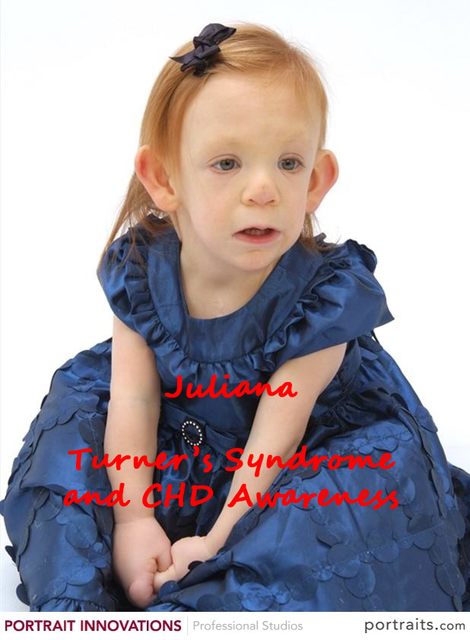
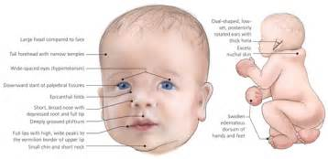

Slide 8
Older children/ Adolescent
Short stature
Infertility: Amenorrhea
Mental retardation(6%)
Increased weight, obesity
hypothyroidism
ADHD
Hypertension
IBD: Crohn disease &ulcerative colitis

Slide 9
Variable Dysmorphic features
-Eyes: ptosis strabismus,amblyopia cataract, epicantal fold can be present,red green color blidness
Ears: serous otitis media, low set ears
Culbitus valgus

Slide 10
Diagnosis
Prenatal
Fetal ultrasonography
Aniocentesis or chorionic villous sampling
Karyotyping
Lab studies:
Gonadotropin: FSH & LH
TFT
HbA1c
Renal ultrasonography
ECG
Audiology

Slide 11
DIFFERENTIAL DIAGNOSIS
Noonan syndrome:
-Noonan syndrome affects both male & female
-It presents with different pattern of congenital heart disease such as pulmonary valve stenosis, ASD & HCM

Slide 12
Complications
Aortic dissection: due to bicuspid aortic valve
Hearing loss
-Common among teenagers due to conductive and sensorinural loss of nerve function
iii. UTI and high blood pessure due to renal obstruction
iv. Hypothyroidism
v. Skeletal problems- scoliosis, kyphosis

Slide 13
Management
Patients with turner syndrome will require screening to carryout early prevention and care which include the following:
Growth Hormone therapy
-To prevent short stature
2. Sex hormone replacement therapy
-Estrogen replacement therapy at age 12-15yrs
Diet:
-Adequate daily intake of calcium & vit D
-TS patients should avoid obesity which increases the risk of hypertention and insulin resistance
4. Regular consultations with:
Endocronologist
Cardiologist
Urologist
Psychologist
Genetics counselling

Slide 14
prognosis
The overall prognosis is good
Life expectancy is slightly shorter than average but may be improved by attention to associated health issues- eg, obesity and hypertention

Slide 15
TREATMENT
There is no known cure
Antibiotics prophylaxis are given to prevent subacute bacterial endocarditis due to MVP & aortic valve disease
Anti hypertensive can be given to treat high blood pressure.

Slide 16
References
Nelson textbook of pediatrics 19e
www.uptodate.com
www.bestpractices.bmj.com

